Slide 1
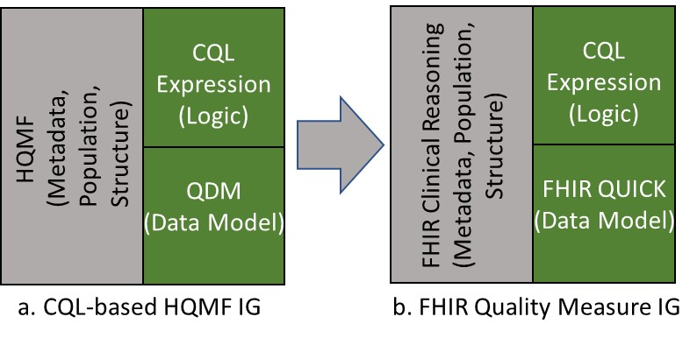
FHIR Clinical Reasoning
(Metadata, Population, Structure)
CQL Expression
(Logic)
CQL Expression
(Logic)
HQMF
(Metadata, Population, Structure)
QDM
(Data Model)
FHIR QUICK
(Data Model)
a. CQL-based HQMF IG
b. FHIR Quality Measure IG

